Slide 1


DevOps Culture and Practice Enablement
Ansible Overview

Slide 2


Topics
Ansible
What is Ansible?
Ansible Playbooks
What are Ansible playbooks and how are they used?
Ansible Roles
What are Ansible roles and how are they used?
Ansible Collections
What are Ansible collections and how are they used?
Notes:
Briefly introduce the topics contained within this page

Slide 3
Ansible
NORTH AMERICA - November 2019 All-Hands Call
Notes:
Accessing Student VMs through Workstation Port Forwarding
Accessing Student VMs through Bastion Port Forwarding

Slide 4
Ansible Introduction & Overview
Ansible – An automation language leveraging modules to be used in one or more tasks on managed systems. Most Ansible automation leverages and Ansible playbook which is a YAML formatted file containing Ansible directives.
Ansible modules – Components used by Ansible tasks and playbooks which are generally implemented and developed in Python. Ansible modules work with certain system utilities and are optimized to be leveraged as a declarative automation language and provide idempotency.
Ansible ad-hoc commands – A way of executing a single Ansible task quickly that relies on a single Ansible module to perform the tests/changes of the task.
Ansible Roles– Curated, independent components of Ansible allowing re-use of common tasks. Roles can consist of variables, tasks, handlers, files, and templates.

Slide 5
Ansible Components & Commands
ansible.cfg – Configuration file for running the ansible and ansible-playbook commands.
Inventory – Inventory file used by the ansible and ansible-playbook commands identifying managed hosts/nodes.
ansible – Command used to perform/execute Ansible ad-hoc commands against a managed node.
ansible-playbook – Command used to execute and run Ansible playbooks
ansible-galaxy – Command to create or utilize Ansible roles. Many of these roles are published on http://galaxy.ansible.com
Playbook – Collection of Ansible tasks organized into one or more Ansible plays.
Task – Collection/list of Ansible modules arranged into instructions. Each task utilizes an Ansible module to perform a given action.
Ansible Module – Specific module (small program generally implemented in Python) which perform the commands and executes the program to get the desired state of a given task.

Slide 6
ansible.cfg File
This file defines the configuration directives which apply directly to how the ansible and ansible-playbook command interact with the Ansible application and which configuration items are applied to a given Ansible session.
./ansible.cfg – When located in the current working directory (CWD) this file is the highest precedence.
~/.ansible.cfg – When located in the user’s home directory, this file will have precedence if an ansible.cfg doesn’t exist in the CWD.
/etc/ansible/ansible.cfg – This is the default configuration file and has the lowest precedence. This file is used when no other ansible.cfg file exists.
Important | It is also possible to define the ansible.cfg file with the environment variable ANSIBLE_CONFIG. If this variable is used, it will override all other configuration files.

Slide 7
Inventory File
The inventory file can contain both Ansible managed hosts/nodes as well as inventory variables to be used for the managed nodes.
Inventory location is generally specified by the ansible.cfg file
./inventory – Common practice to leverage inventory files with playbooks and the ansible.cfg file in the current working directory
/etc/ansible/hosts – Default inventory file deployed with the Ansible package

Slide 8
Ansible Playbooks
NORTH AMERICA - November 2019 All-Hands Call
Notes:
Instructor ToolKit
MOJO - New Site
RHLC
Knowledge management
RHU ROL / public ROL

Slide 9
Playbook Structure
---
- name: Ansiblize Managed Hosts
hosts: localhost
vars_files:
- variables.yml
tasks:
- name: Create Ansible User
debug:
msg: This will use the USER module
handlers:
- name: Restart SSHD
debug:
msg: This sill use the SERVICE or SYSTEMD

Slide 10
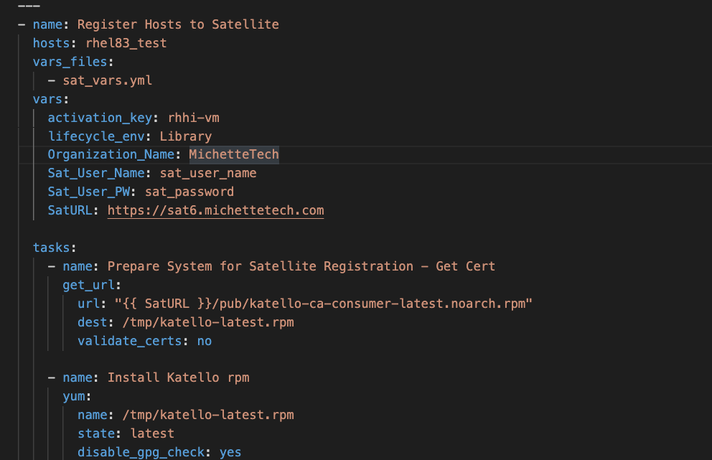
Sample Playbook

Slide 11
Ansible Roles
NORTH AMERICA - November 2019 All-Hands Call

Slide 12
Ansible ROLE Structure
[student@workstation ROLES]$ tree My_Role/
My_Role/
├── defaults
│ └── main.yml
├── files
├── handlers
│ └── main.yml
├── meta
│ └── main.yml
├── README.md
├── tasks
│ └── main.yml
├── templates
├── tests
│ ├── inventory
│ └── test.yml
└── vars
└── main.yml
8 directories, 8 files

Slide 13
Ansible ROLE Structure
Subdirectory | Function of Directory
defaults | The main.yml file contains default variable values that are used by the role. These have the lowest precedence and priority.
files | Contains files that are used by the tasks in the role.
handlers | The main.yml file contains handlers that are executed by the role.
meta | The main.yml file contains information about the role. At a minimum you should modify the author, license, platforms, and dependencies.
tasks | The main.yml file contains the tasks being used by the Role.
templates | Contains Jinja2 templates used by tasks in the role.
tests | Contains an inventory and test.yml playbook that can be used to test the role.
vars | The main.yml file contains role variables and values. These are high precedence and not intended to be changed when used in a playbook.

Slide 14
Ansible Collections
NORTH AMERICA - November 2019 All-Hands Call

Slide 15

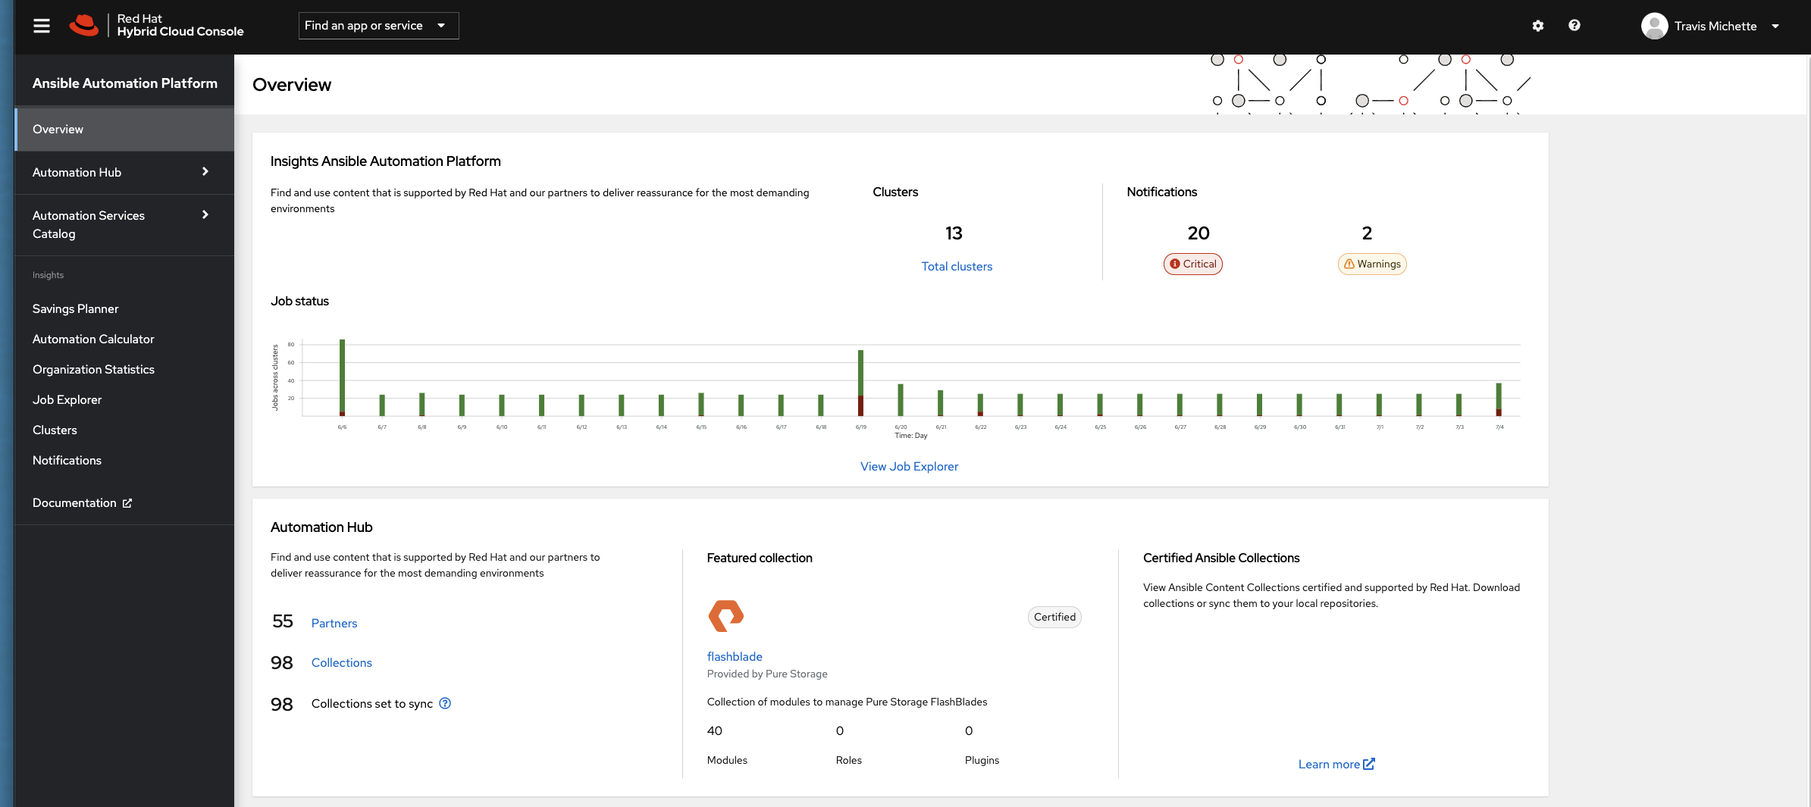
Ansible Collections – The Future
Ansible Collections – A new method and standard of delivering and distributing Ansible automation components. Collections can consist of Ansible modules, playbooks, roles, and plug-ins.

Slide 16
References & More Information
NORTH AMERICA - November 2019 All-Hands Call

Slide 17
Additional Resources
Ansible Automation Platform – https://console.redhat.com/ansible/ansible-dashboard
Ansible Documentation – https://docs.ansible.com/ansible/latest/index.html
Github with Sample Playbooks – https://github.com/tmichett/AnsiblePlaybooks
Ansible Roles Creation (LUG Presentation)
Github - https://github.com/tmichett/LUG/tree/main/Ansible_Roles
YouTube - https://www.youtube.com/watch?v=UoY5QZ0dzbo&t=31s
Red Hat Training Courses: RH294, DO417 (Windows), DO447, DO457 (Networking)

Slide 18
Thank you
Red Hat is the world’s leading provider of enterprise open source software solutions. Award-winning support, training, and consulting services make Red Hat a trusted adviser to the Fortune 500.
E-Mail: tmichett@redhat.com

